Slide 1
Introduction to Scattering Theory
Y.-H. Song(RISP,IBS)
2017.July.04 The 2nd RISP Intensive Program on Rare Isotope Physics

Slide 2
There are many good books for scattering theory or reaction
Here we will skip detailed discussion on the scattering theory and try to summarize important concepts and equations
Non-relativistic theory.
No tensor force, or spin-dependent force

Slide 3
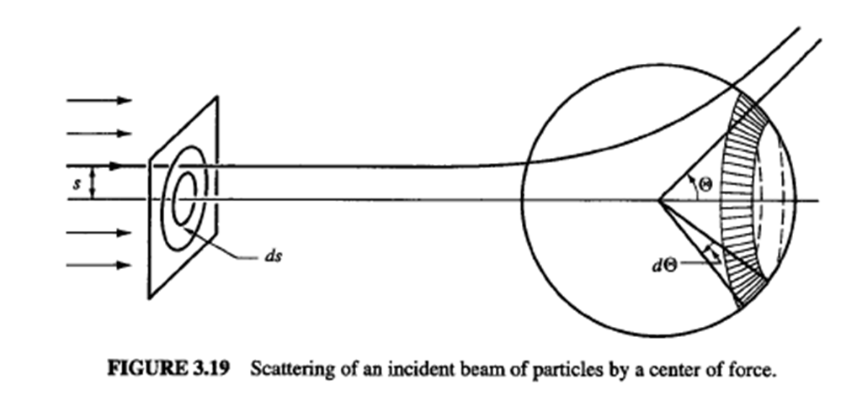
Scattering
(Goldstein 3-19)
Classical Mechanics : Interaction -> Trajectory -> Cross section
Quantum Mechanics : Interaction -> Probability-> Cross section
For the probability interpretation, the wave function have to be normalized.
Thus, it is natural to consider time evolution of a Wave packet for scattering.
(non-stationary solution of Schrodinger equation)
But, in practice, it is easier to describe the scattering
in terms of plane waves(stationary, non-normalizable).

Slide 4



Kinematics
Separation of C.M. motion and relative motion
Reduced mass
Natural unit
C.M. motion is trivial (Momentum Conservation)
only interested in the relative coordinate
→ C.M. frame : Simplification of two-body problem into one-body problem

Slide 5
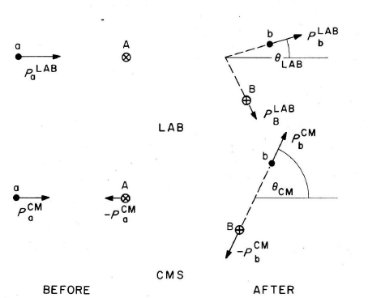
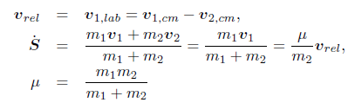

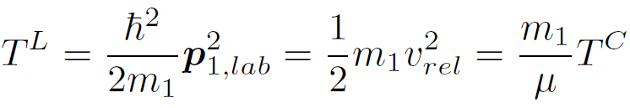
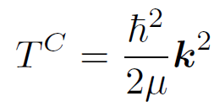

Kinematics
Before collision
(Satchler fig2.1)
In elastic scattering, (kinetic) energy is conserved.

Slide 6
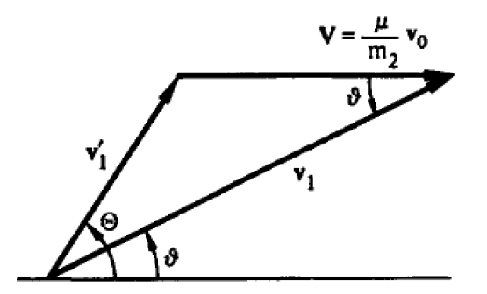

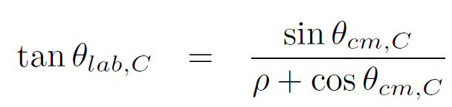
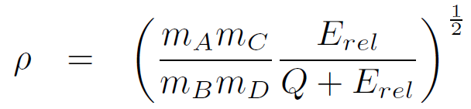


Kinematics
vcm
vlab
Q= (mA+mB –mC -mD) c^2,
Q=0 for elastic scattering
Cross section at lab frame and at CM frame
(H.W.) prove the relation between
Lab angle and CM angle
(H.W.) relativistic kinematic relations

Slide 7
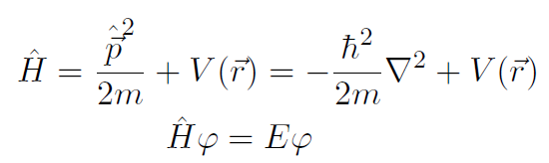


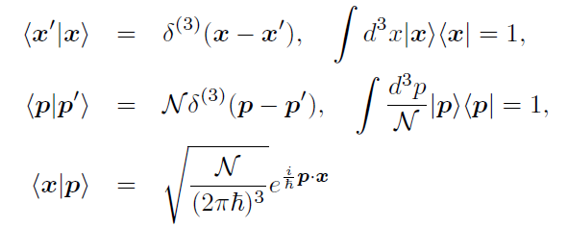
Plane Wave
Time independent Schrodinger equation
free particle solution : Plane wave
Bra-ket notation and normalization

Slide 8



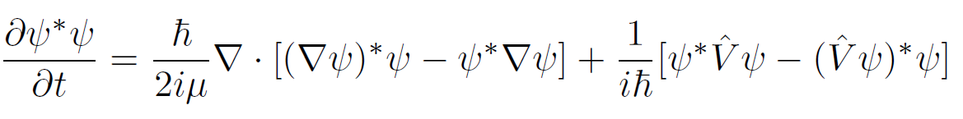

Current
From continuity eq. and Schrodinger eq.
The last term vanishes for local Hermitian interaction.
In general, interactions are non-local.
Free Current density
Plane wave Case : (density)*(velocity)

Slide 9
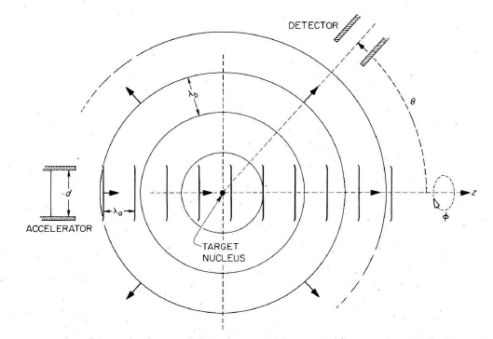
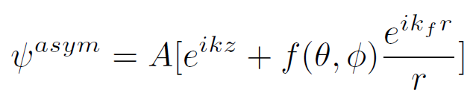
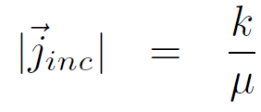
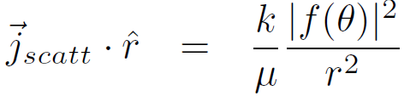
Asymptotic Form of scattering wave
If interaction have finite range,
Asymptotic boundary condition
Incident wave + scattered wave
f : Scattering amplitude
f=0 , if there is no potential
(Satchler Fig. 3.1)
Then incident flux and scattered flux at large distance
(H.W.) show this

Slide 10
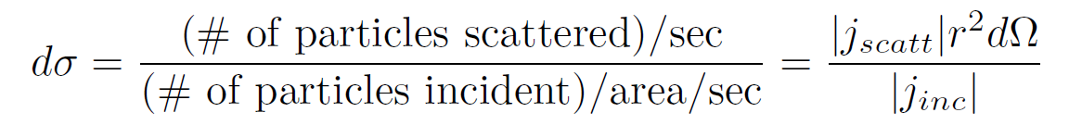
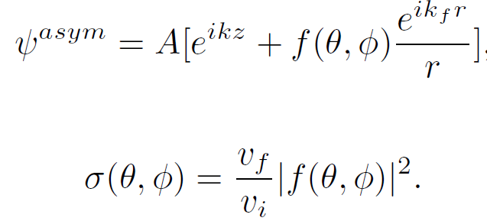
Cross section
Cross section for the scattering into solid angle
Differential Cross section
Angle Integrated Cross section → “total” cross section
We will use “total” cross section
as a sum of elastic cross section and non-elastic cross section.

Slide 11
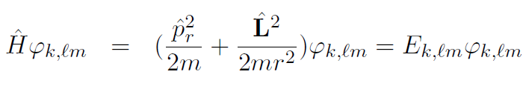


Partial Wave Expansion
Since the angular momentum is conserved in scattering, it is convenient to use angular momentum eigenstate as a basis. → Partial wave expansion
Free particle
The regular solution of radial equation is spherical Bessel function
→ Plane wave can be expanded by spherical Bessel function and Spherical Harmonics

Slide 12
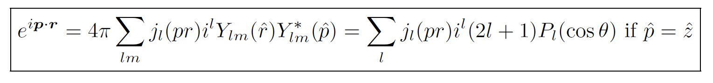

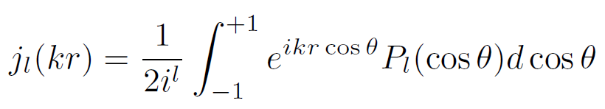
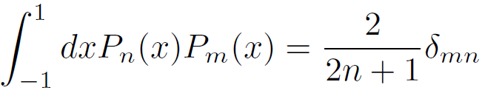
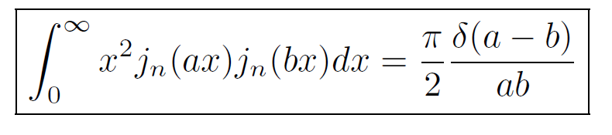
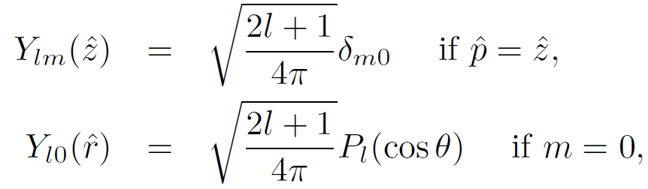
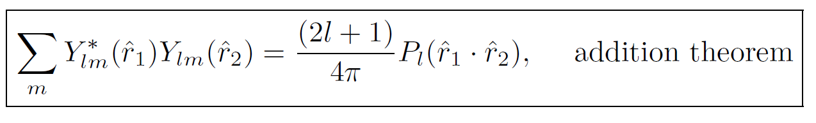
Partial Wave expansion of plane wave
(H.W.) Prove this relation
Useful equations

Slide 13
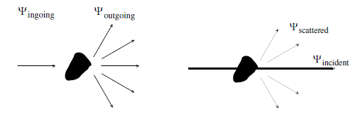
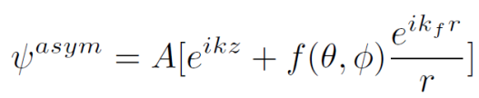
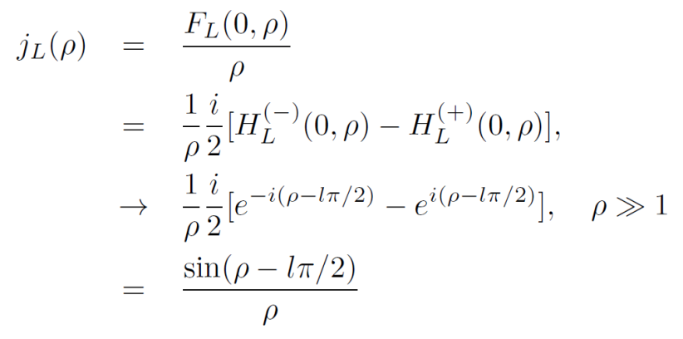
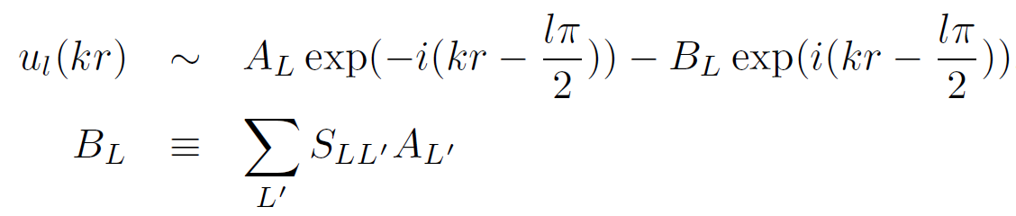

S-matrix
Incident wave contains both ingoing and outgoing wave
Scattered wave should only contain outgoing wave
Thus, the effect of scattering may be expressed as
(Complex) S-matrix to the outgoing wave part
Unitarity implies |S|=1

Slide 14
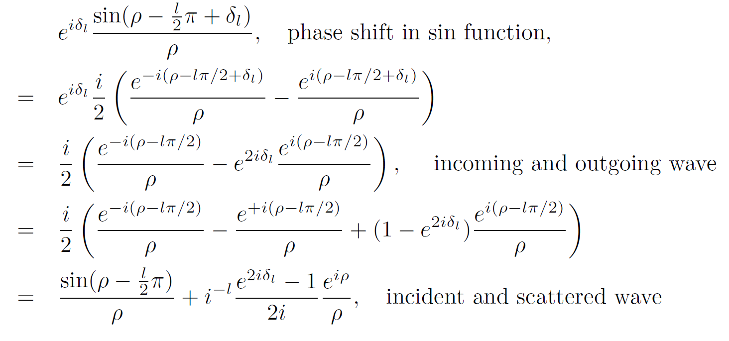
Phase Shift
From unitarity, we can introduce phase shift in the asymptotic form

Slide 15
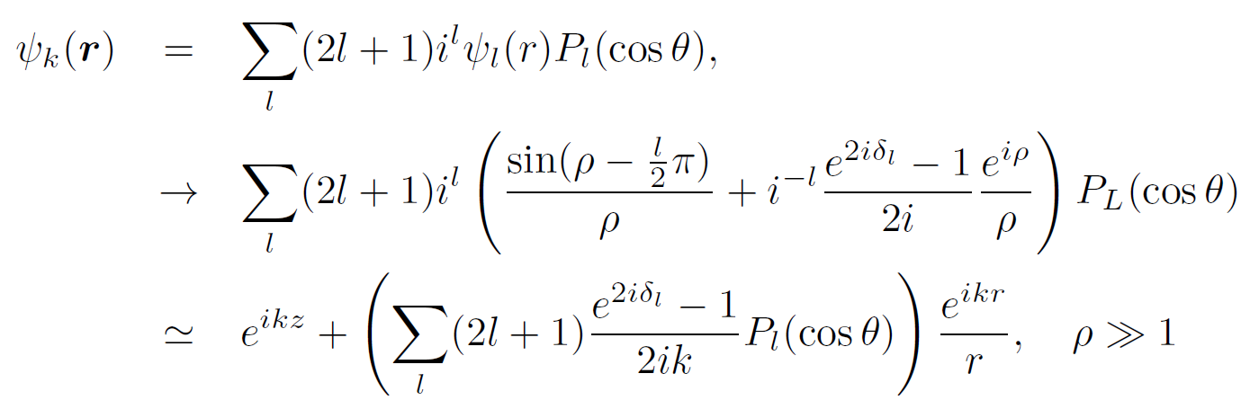
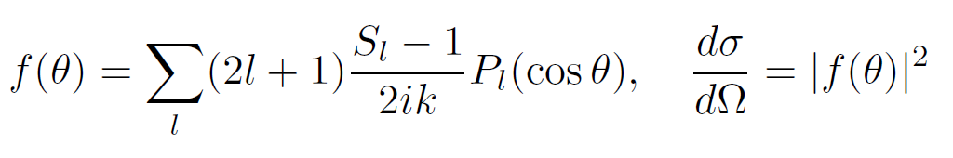
Phase shift, S-matrix, Scattering amplitude and Cross section
Using this relation, we can relate the S-matrix (phase shift) with the
Asymptotic form of wave function, scattering amplitude
And finally cross section.

Slide 16

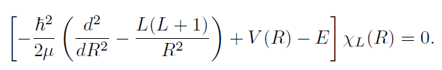




Coulomb functions
Coulomb interaction is long range
Coulomb functions
Sommerfeld parameter
Spherical Bessel (Neumann) function is a special case with eta=0, V=0

Slide 17


Coulomb functions
Coulomb-Hankel function
Asymptotic Forms
Coulomb phase shift
For the moment, let us ignore Coulomb interaction, eta=0.
Thus, Coulomb functions and Coulomb-Hankel functions simply corresponds to
Spherical Bessel functions and (ingoing, outgoing waves).

Slide 18
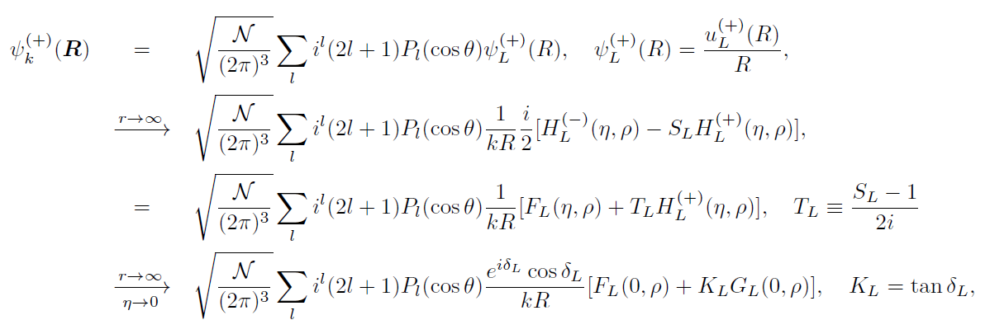

S-,T-,K-matrix
In terms of Coulomb functions, we may express the asymptotic form in many ways
(H.W.) confirm these relations
K-matrix is real-valued

Slide 19


How to get the phase shift from Schrodinger equation
All we need is a phase shift
Numerical Solution of Schrodinger equation by numerical integration(Runge-Kutta, Numerov…)
Boundary Condition: B and S are unknown

Slide 20

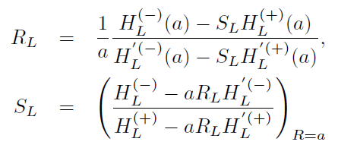
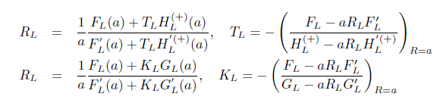
How to get the phase shift from Schrodinger equation
Continuous Matching condition at matching radius r=a
R-matrix
Then, we get S-matrix

Slide 21
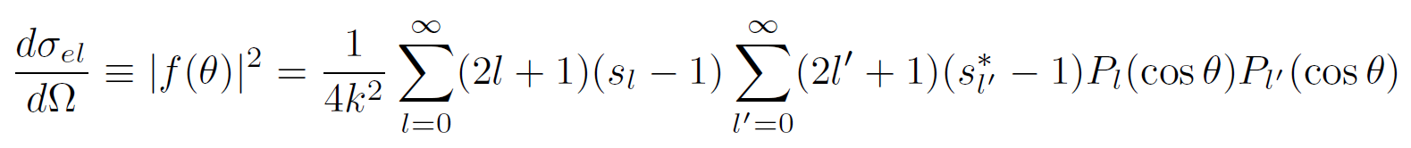
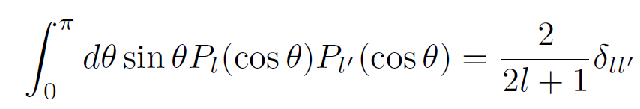

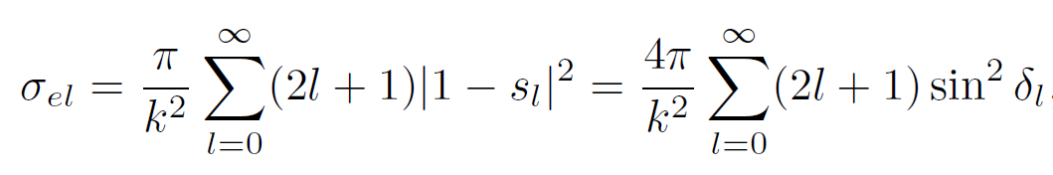
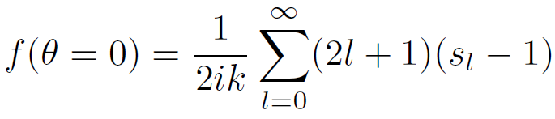

Optical theorem
when |s|=1

Slide 22
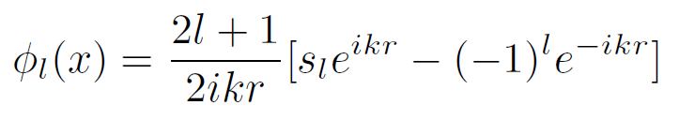
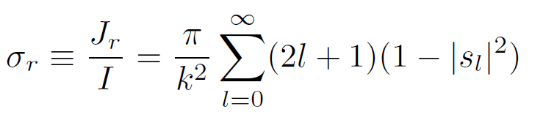
Reaction(absorption) Cross section
In fact, the optical theorem holds even when the phase shift is complex ( |s|<1, thus disappearing flux ) , if we define
(total cross section)=(elastic cross section)+(reaction cross section)
(reaction cross section) describe the disappearance of flux ~ absorption
~ Complex potential
Total flux into the sphere:
Reaction cross section = ratio between (incident flux) and (disappeared flux)

Slide 23

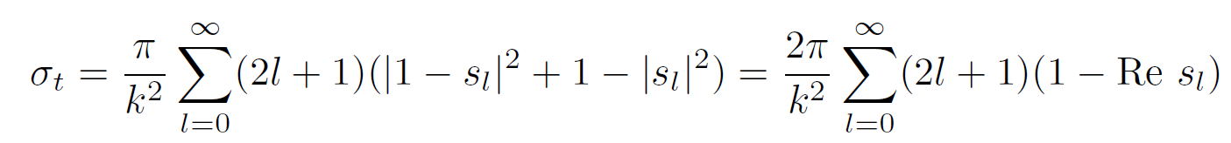
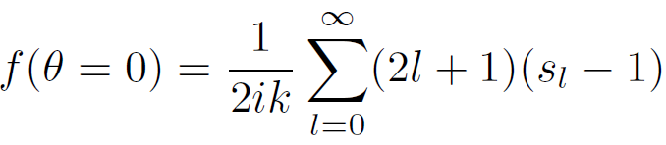
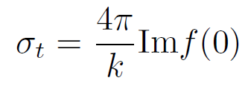
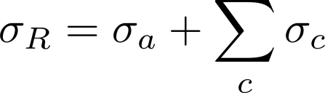
Optical Theorem (with reaction)
When other reaction channels are explicitly considered:

Slide 24


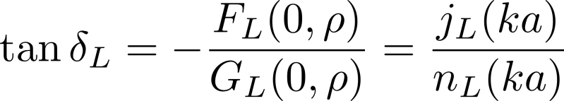
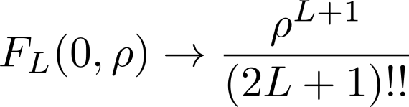




Example: Hard sphere scattering
R-matrix is zero at the boundary
Low energy limit
At low energy, only S-wave is important

Slide 25
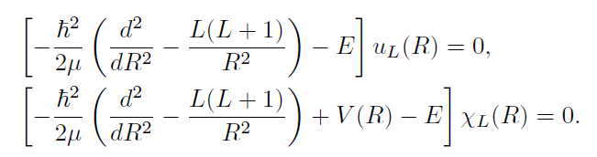


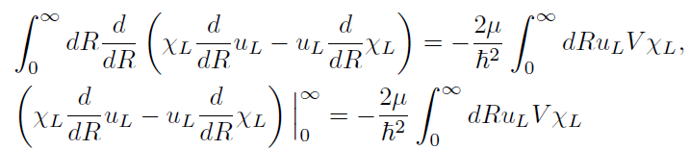
Phase shift and potential
Difference of two equation
Integrate

Slide 26

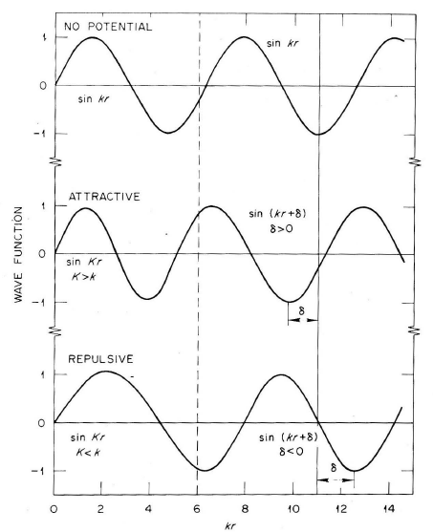

Phase shift and potential
Wronskian
Relation between Phase shift and potential
By using asymptotic form of wave
(this relation depends on the choice of convention)
For weak potential V, Born approximation gives
Repulsive V → negative phase shift
Attractive V → positive phase shift
(Satchler Fig.3.4)

Slide 27



Low energy limit
Low energy limit
For L=0, (phase shift)→ - k*(constant) .
Scattering length can be defined as
Wave function at low energy

Slide 28






Effective Range Expansion
In low energy limit, only S-wave is important
Consider two S-wave solutions at different energies
Consider asymptotic form with phase shift
Take difference
Take a zero energy limit for k1

Slide 29



Effective Range Expansion
scattering length a
effective range is a measure of range of potential
Effective range expansion
Low energy scattering
Can be determined
by just two parameters,
Scattering length and effective range

Slide 30




Resonance
Phase shift~ pi/2
Scattering amplitude(cross section) becomes maximum
~ can be a indication of resonance
Fig. from lecture of C. Elster
Resonance
~ quasi bound state
~ long time delay in wave packet
~ peak in cross section
~ pole of S-matrix at complex energy

Slide 31






Resonance
S-wave neurton scattering
The amplitude in internal region becomes
Large when the derivative of wave function
Becomes zero.
(Satchler’s book)
(Shape elastic)~ no penetration to internal
~ hard sphere case
Elastic~|(shape elastic)+(compound elastic)|^2

Slide 32

Resonance
Elastic~|(shape elastic)+(compound elastic)|^2
Absorption cross section and compound part
Have maximum at x=0.
Near resonance energy

Slide 33





Resonance
Breit-Wigner resonance
When shape elastic part is negligible,
Cross section becomes Breit-Wigner Form
Near the resonance
(I.J.Thompson’s book Fig3.3)

Slide 34







Formal theory of scattering
Taylor’s book Fig.2.3.
Moller operator
Scattering operator

Slide 35




Formal theory of scattering

Slide 36



Formal theory of scattering
(Resolvant)

Slide 37






Formal theory of scattering
Lippmann-Schwinger equation
→ Coordinate space representation

Slide 38


Free Green’s function
(+/-) indicate boundary condition
Contour in upper half plane

Slide 39






Scattering amplitude

Slide 40




LS equation for t-matrix
T-operator
LS equation for T-operator

Slide 41




LS equation for t-matrix
Convention dependent
half-on-shell equation( no-restriction on k’ or k tilde)
The phase shift(scattering amplitude) can be obtained from on-shell T-matrix

Slide 42

Born Series
If potential is strong, the born series may have bad convergence.
Distorted Wave Born Approximation can be used
( Non-perturbative treatment of part of interaction)

Slide 43


Born Approximation/Series

Slide 44



S-matrix
Energy-conservation factor can be factored out→ on-shell S-matrix
Relation between S-matrix, T-matrix, and potential

Slide 45
How to solve LS equation for T-matrix
Requires partial wave expansion, discretization of momentum space ,
proper treatment of singularity in the integral
Partial wave decomposition (depends on convention)

Slide 46




How to solve LS equation for T-matrix
Principal value Integral
Discretization : Gaussian Quadrature
On-shell T-matrix gives phase shift, scattering amplitude

Slide 47


Scattering of identical particles
Until now, we assumed that the two particles are distinguishable.
When two identical particle are scattering, the wave function have to be symmetric(anti-symmetric) for bosons( fermions)
→ Equivalently to sum two scattering amplitude
I.J. Thompson’s book fig. 3.8

Slide 48


Scattering of identical particles
Anti-symmetric
two-nucleon wave function
L+S+T =(odd)
pp or nn scattering, T=1
S=0 : only even L
S=1 : only odd L
(I.J. Thompson’s book)

Slide 49



Two potential formula
Suppose there are strong potential and weak potential
(Plane wave)
(Distorted Wave)
(Full scattering wave)

Slide 50



Two potential formula

Slide 51


Two potential formula
Thus we get two-potential formula

Slide 52




Distorted Wave Born Approximation
Thus DWBA treat strong potential (or Coulomb) non-perturbatively
but treat weak potential perturbatively.
Note that we have to use correct boundary conditions
(H.W.) Find Corresponding relation
for partial radial wave function

